Slide 1
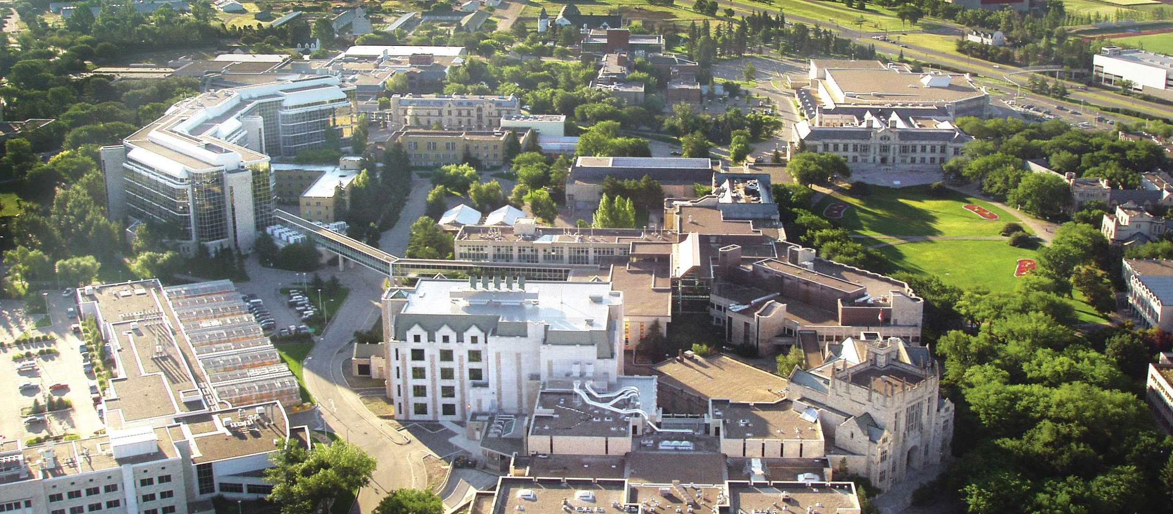


Agent-Based Modeling and Truck Driver Health and Safety
www.usask.ca

Slide 2
The Long-Haul Truck Driving Profession:
Who They Are, and What They Do
Transport goods across vast distances, often with unpredictable routes based on freight demands
~2,000,000 drivers in the U.S.
300 billion miles driven annually
$800 billion in gross freight revenues annually, accounting for 80% of the nation’s total freight bill
Emerged as essential occupation for implementation and sustainability of COVID-19 policies and strategies
Notes:
Truck drivers are a lynchpin in the American economy, yet are often overlooked for their importance in our day-to-day lives
↓↓↓↓↓↓↓↓↓↓
↓↓↓↓↓↓↓↓↓↓
↓↓↓↓↓↓↓↓↓↓
↓↓↓↓↓↓↓↓↓↓
Emerged: Stay-at-home orders, vaccine delivery, etc.

Slide 3
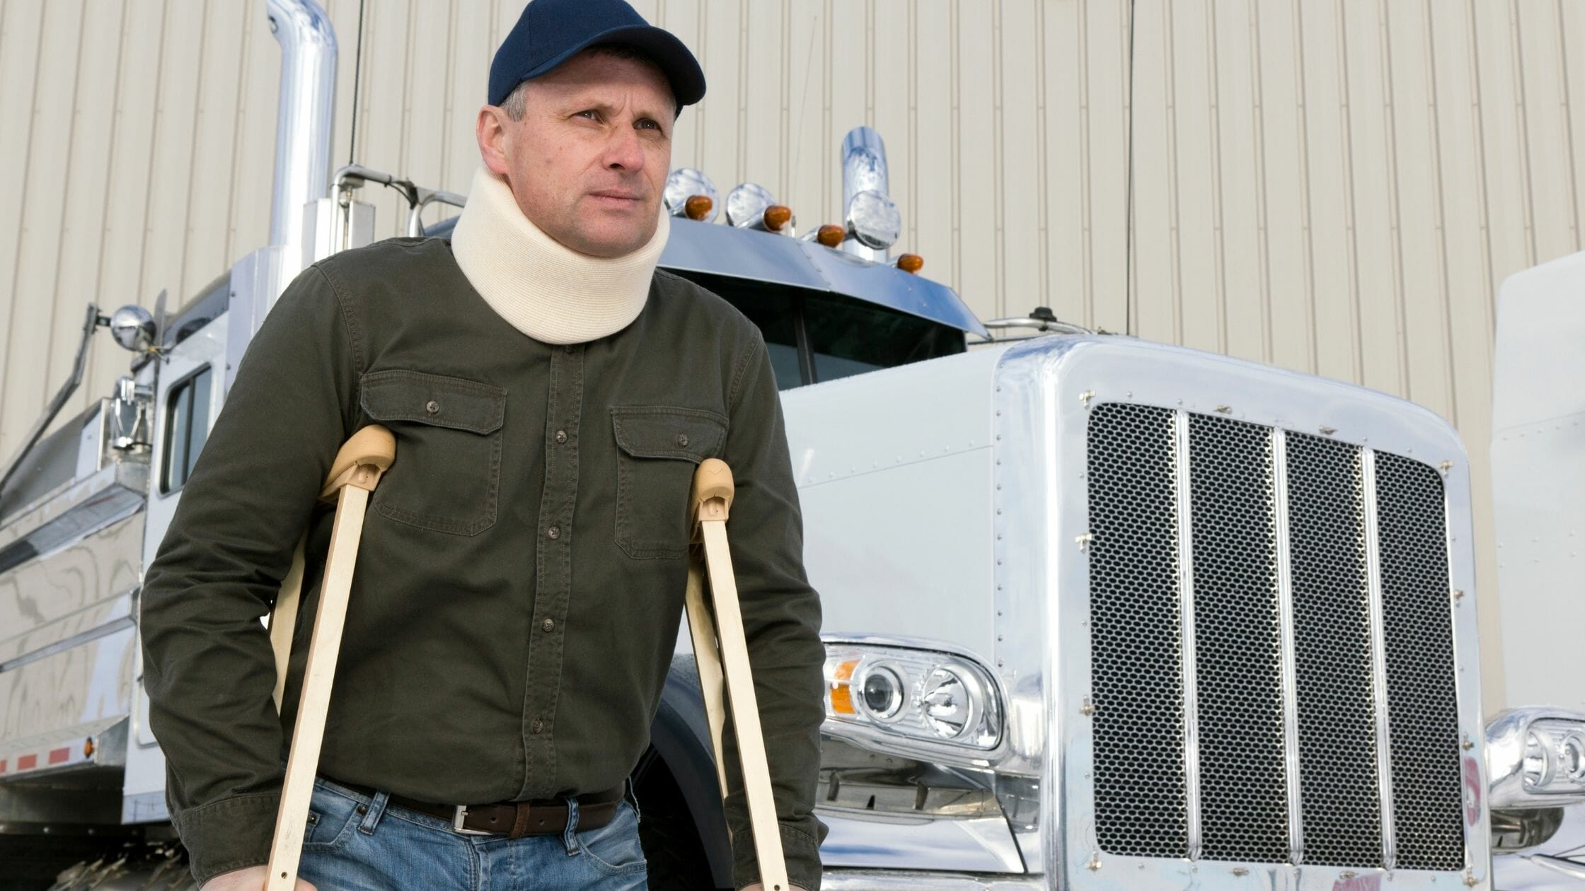
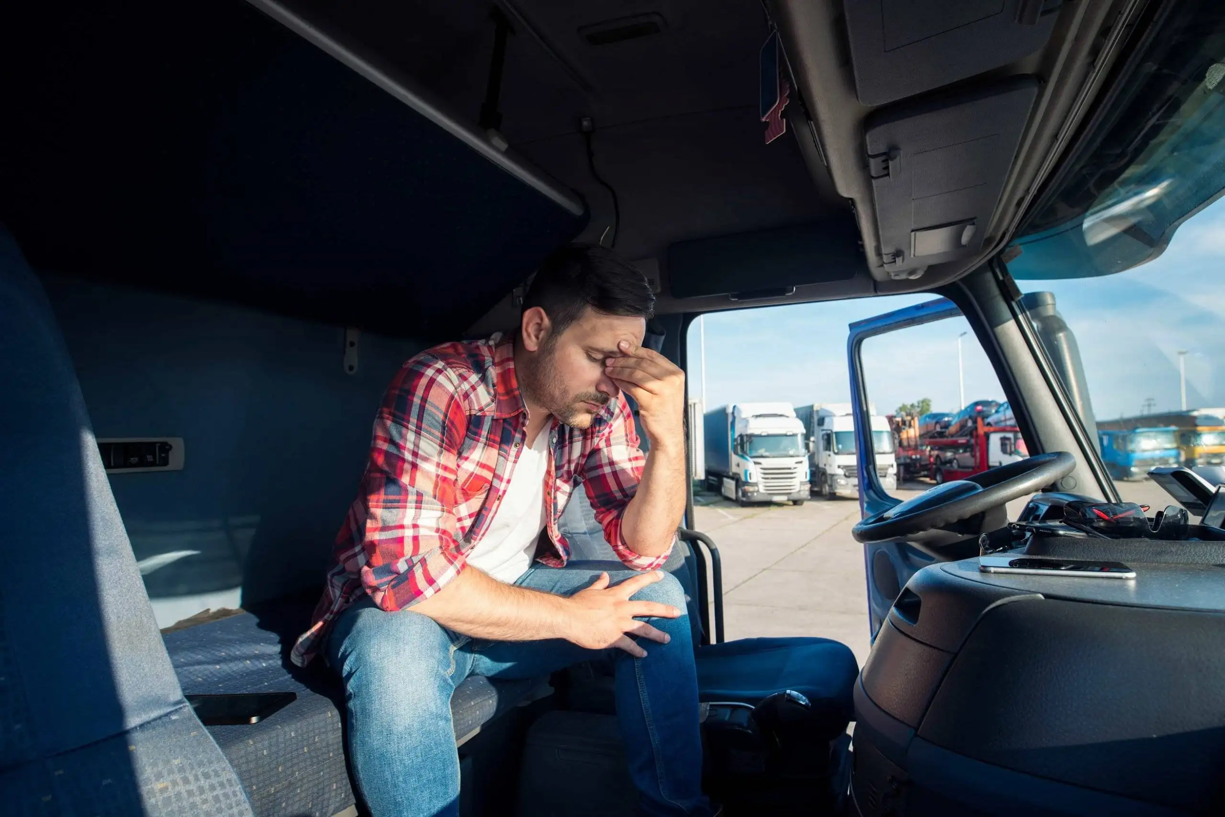
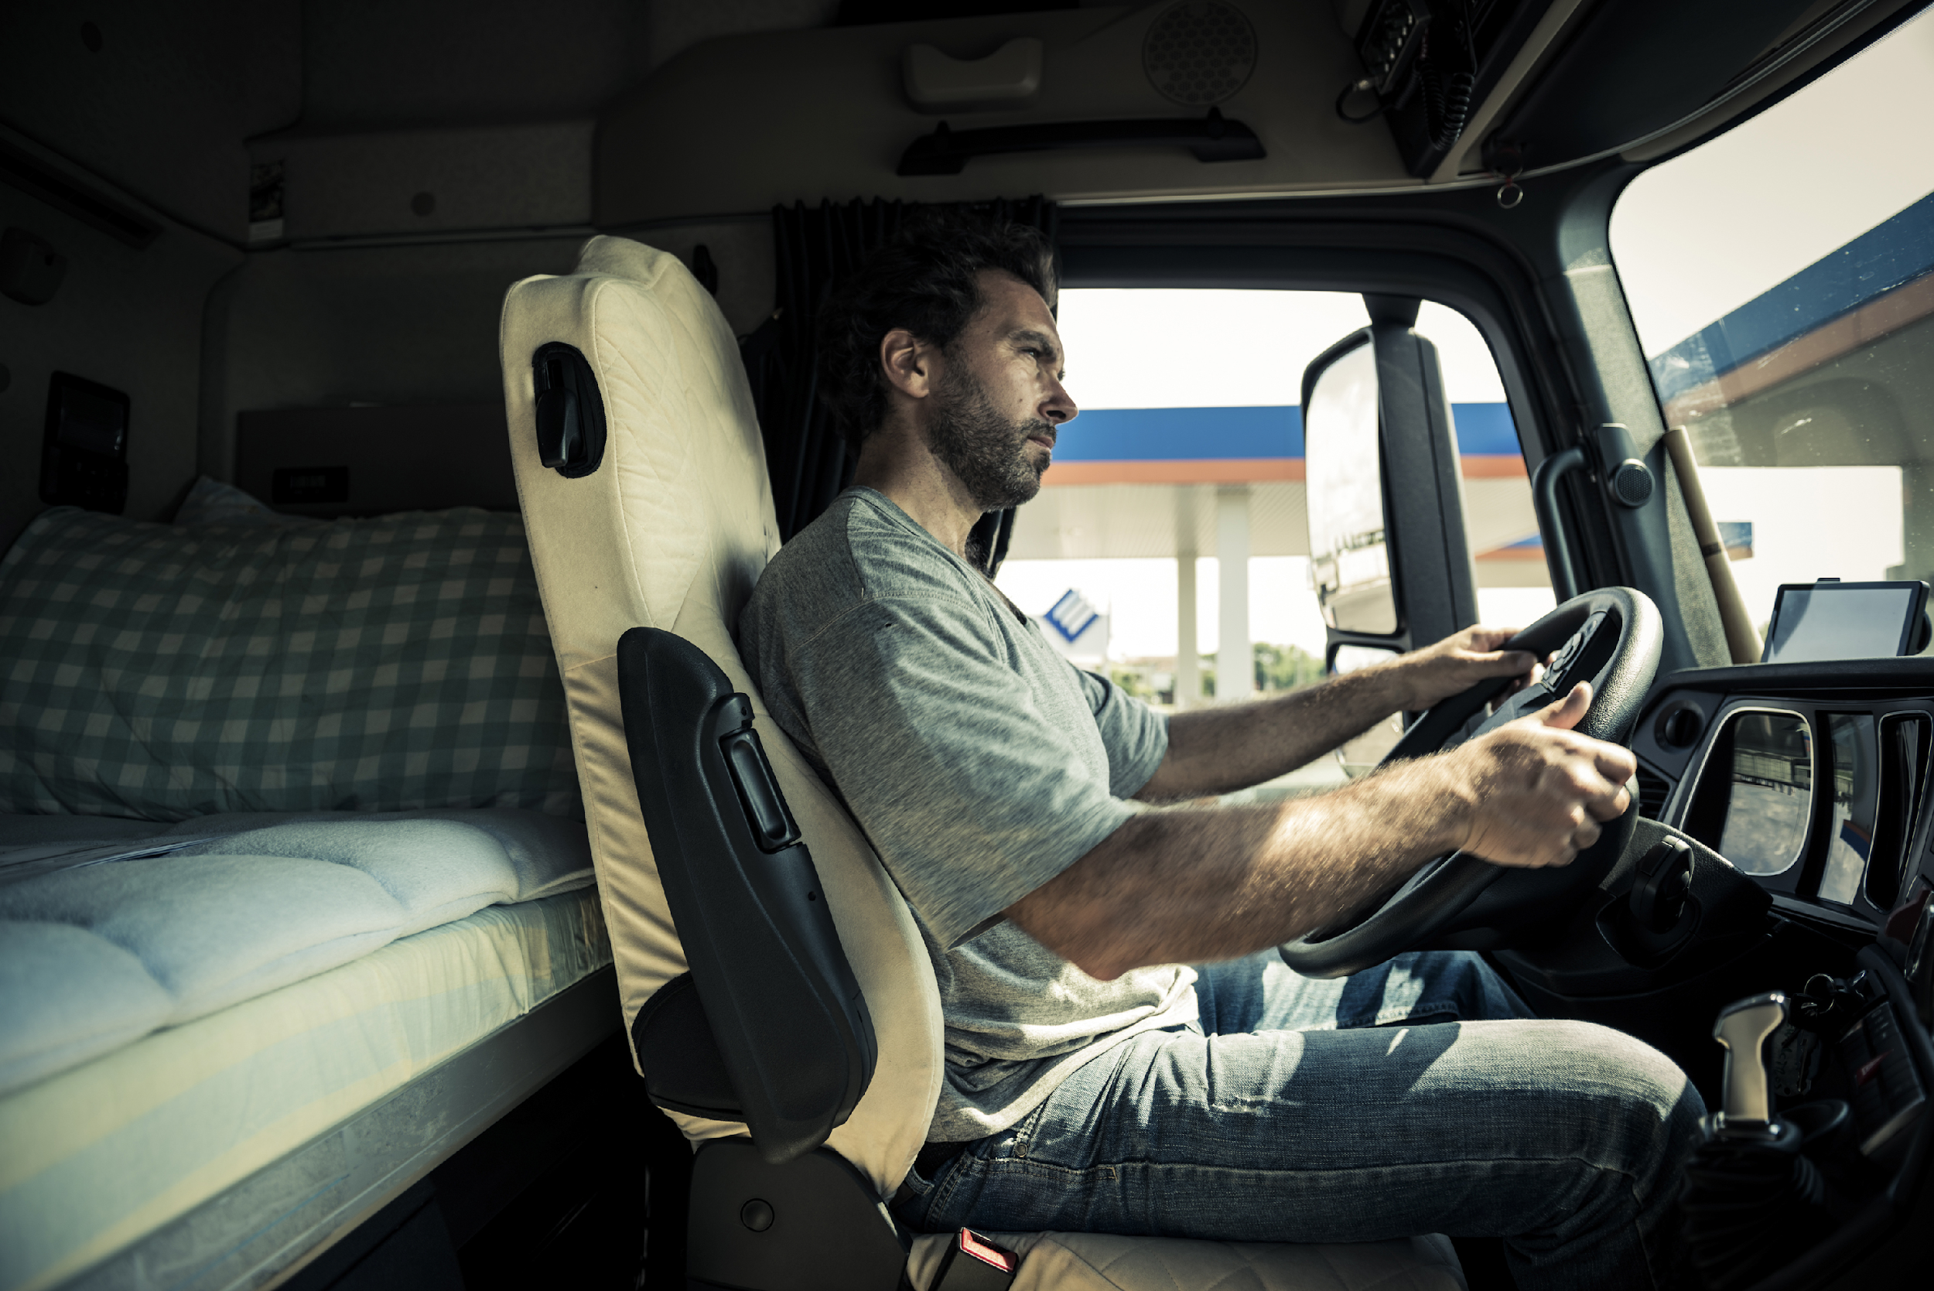
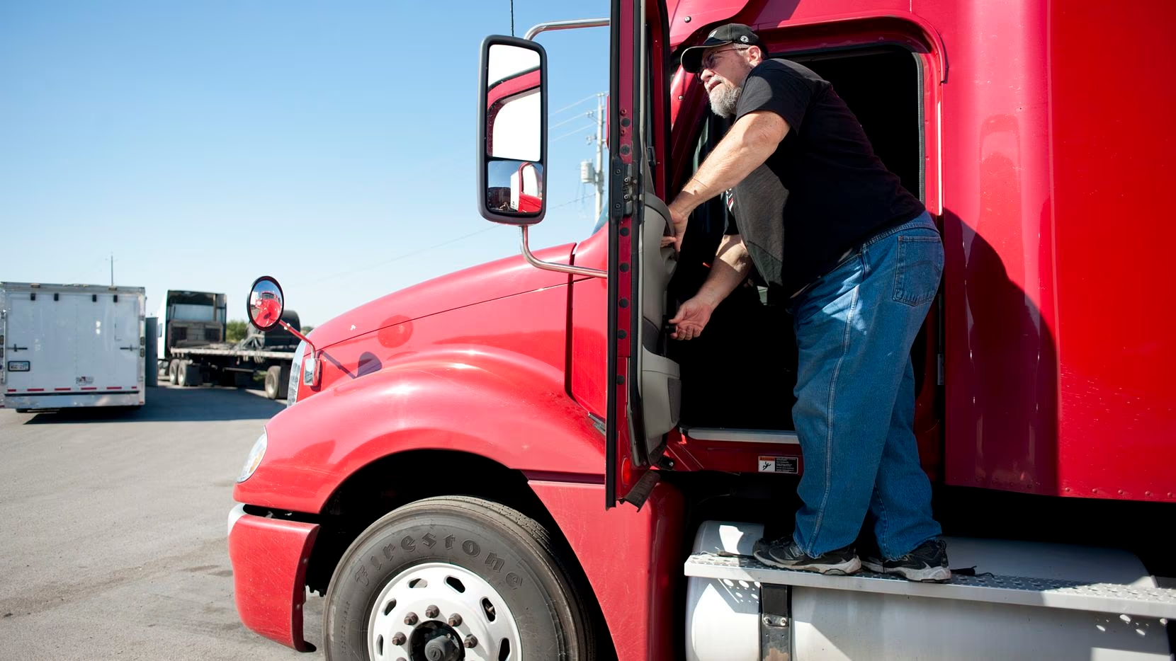
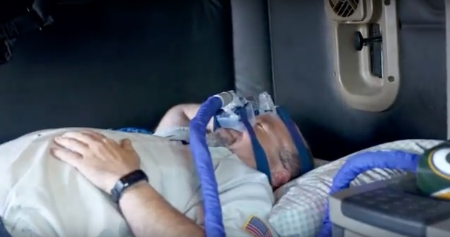
The Long-Haul Truck Driving Profession:
Health and Safety Disparities
Notes:
Long-haul truck driving is harmful to physical and mental health
These disparities can be broadly classified into four areas
↓↓↓↓↓↓↓↓↓↓
Cardiometabolic disparities
Cardiovascular disease
Metabolic Syndrome
↓↓↓↓↓↓↓↓↓↓
Acute and chronic injury disparities
Roadway crashes
Musculoskeletal injuries
↓↓↓↓↓↓↓↓↓↓
Mental health disparities
Psychiatric/mental health disorders
Work-induced or –exacerbated behavioral risks
↓↓↓↓↓↓↓↓↓↓
Other disparities
Sleep disorders
Chemical exposures (e.g., worksite pollution)

Slide 4
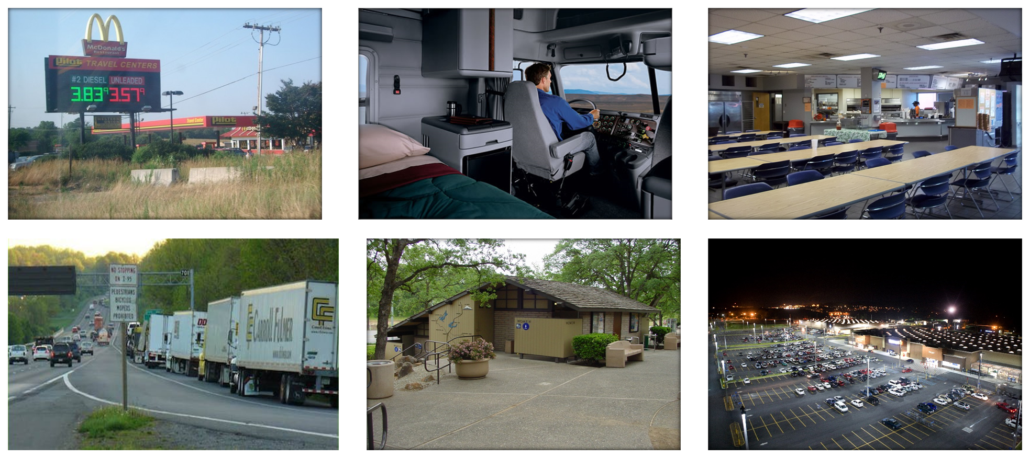
Truck Driver Worksites
Notes:
Beyond LHTD, environmental characteristics – especially worksites – are uniquely important to LHTD health and safety outcomes
LHTD encounter a diverse array of worksites during their work, including…
Truck stops
Their truck cabs
Company facilities
Rest and parking areas
And Wal-Marts
To name a few

Slide 5
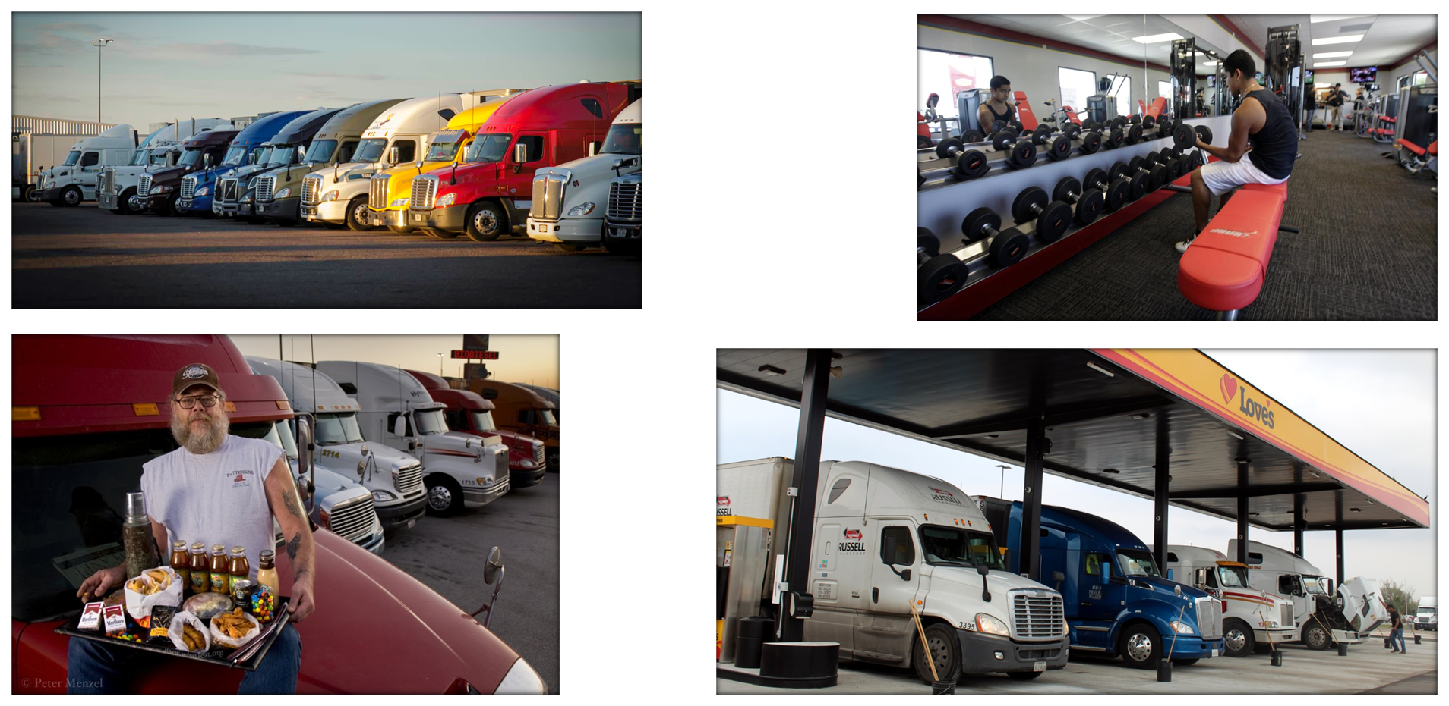
Worksites Provide Basic Needs
Notes:
Understanding these worksites is crucial, because truck drivers are reliant on the attributes of these locales to meet their basic needs while on the road, including sleep, physical activity, nutrition, and fueling

Slide 6
Why ABM for Trucker Health and Safety?
Truck driver health and safety outcomes are dynamically complex
ABM is uniquely adept for capturing key causal mechanisms – or generative mechanisms – that give rise to truck driver health and safety outcomes
These mechanisms are currently hypothesized as four ‘archetypes’ that constitute the ‘architecture’ of our baseline model
Notes:
Because they are dynamically complex, policy resistance is an important threat to any prevention endeavors
Uniquely adept: As we will discuss, these mechanisms embody several complex systems concepts that correspond with the strengths of ABM
By “give rise”, we are referring to emergence

Slide 7
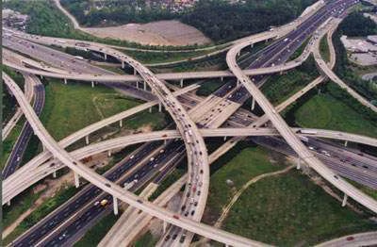
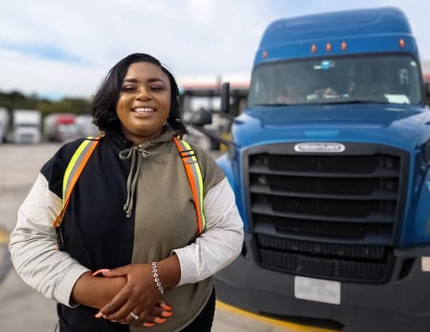
Archetype 1: Stochastic Mobility
Notes:
Stochastic mobility – drivers have highly unpredictable routes that are contingent on factors that are difficult to forecast beyond a short time period
Complex systems theoretical concepts: Temporal (dynamic) effects (e.g., delays; path dependence)
Implications for health/safety: Effects of driver routing/dispatching on exposures – for many routes, there is usually a limited number of roadways that can feasibly be taken, with corresponding constraints on what resources can be accessed along these routes

Slide 8
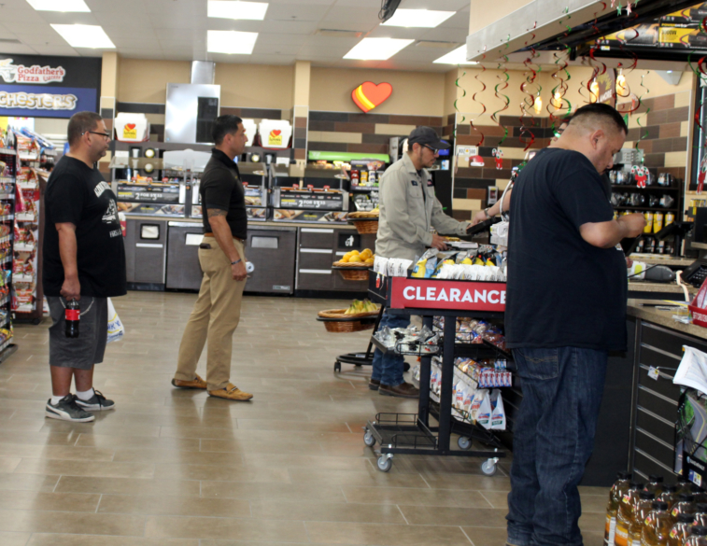
Archetype 2: Vulnerable Network Characteristics
Notes:
Vulnerable network characteristics – driver networks are noted for having properties that may amplify risks of spread (e.g., infectious disease; information) across networks
Complex systems theoretical concepts: Feedbacks/reciprocal causality through agent-agent and agent-environment interactions that generate nonlinearities
Implications for health/safety: Agent-agent interactions in the acquisition/transmission of infectious disease, and potential of latent tipping points in spread of disease along trucker networks

Slide 9
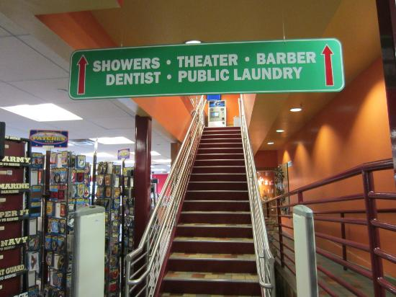
Archetype 3: Dependence on Constrained Resource Environments
Notes:
Dependence on constrained resource environments – drivers are uniquely dependent on roadside built environments for basic needs, yet have limited volition in the selection of resources due to their large vehicles that limit the array of resources that can be accessed
Complex systems theoretical concepts: Heterogeneity (among individuals and explicit spatial environments)
Implications for health/safety: Differences among truck stop entities (e.g., chain vs. independent locations) in characteristics of retail food environments

Slide 10
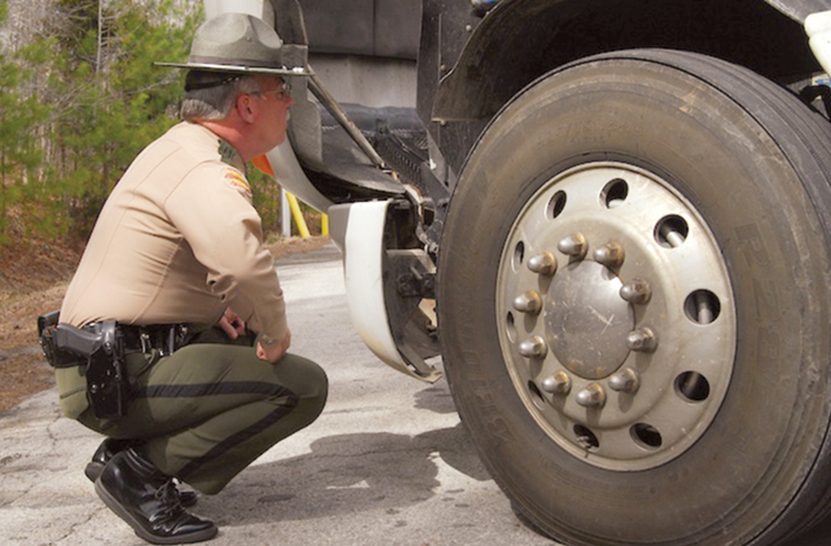
Archetype 4: Restrictive Policy Environment
Notes:
Restrictive policy environment – driver behavior ‘rules’ are governed by a dizzying array of federal, state, and corporate policies pertaining to work hours, rest hours, vehicle inspections, medical certification, operating procedures, etc.
Complex systems theoretical concepts: Disaggregated (individual-level) characteristics (e.g., effects of local environment/localized perception; diverse actors) and behaviors (e.g., siloed perception, decision-making, learning, and adaptation based on context)
Implications for health/safety: Varied adherence to trucking industry policies (e.g., compliance with hours-of-service regulations)

Slide 11
The Truck Parking Problem
As a case study, the first iteration of the truck driver model will focus on a major issue – the lack of safe and available truck parking
Lack of safety and available truck parking has numerous implications for truck driver health and safety…and the safety of the motoring public as well!
Current solutions appear to be low-leverage
Can ABM identify novel, high-leverage solutions?
Notes:
We chose this for a case study because it is somewhat less complex – especially compared to problems such as nutrition (where driver behavior and preferences are more salient)
Long-haul truck drivers do not go home every night – they sleep in their trucks
Lack of safe and available truck parking has implications for roadway safety, sleep health, mental health and physical safety
Low-leverage – spatiotemporally limited in scope, behavior-based, and not up to the task given the dynamic complexity of the problem – thus, rife for policy resistance

Slide 12
The Truck Parking Problem
As a case study, the first iteration of the truck driver model will focus on a major issue – the lack of safe and available truck parking
Lack of safety and available truck parking has numerous implications for truck driver health and safety…and the safety of the motoring public as well!
Current solutions appear to be low-leverage
Can ABM identify novel, high-leverage solutions?
Notes:
We chose this for a case study because it is somewhat less complex – especially compared to problems such as nutrition (where driver behavior and preferences are more salient)
Long-haul truck drivers do not go home every night – they sleep in their trucks
Lack of safe and available truck parking has implications for roadway safety, sleep health, mental health and physical safety
Low-leverage – spatiotemporally limited in scope, behavior-based, and not up to the task given the dynamic complexity of the problem – thus, rife for policy resistance

Slide 13
Model Implementation
Drivers interact within a realistic GIS environment
Drive between random cities
Use decision-making process to find truck stops
Drivers interact at truck stops
Truck stops may or may not have enough space for drivers to park
Key components
  Trucker behaviour
  Trucker routing
  GIS data

Slide 14
Model Implementation
Data collection
  Online datasets for cities and rest areas
  Allstays dataset – aimed at truck drivers and RV enthusiasts
Truck routing
  Very interesting and non-trivial problem
  Will not be discussing today

Slide 15
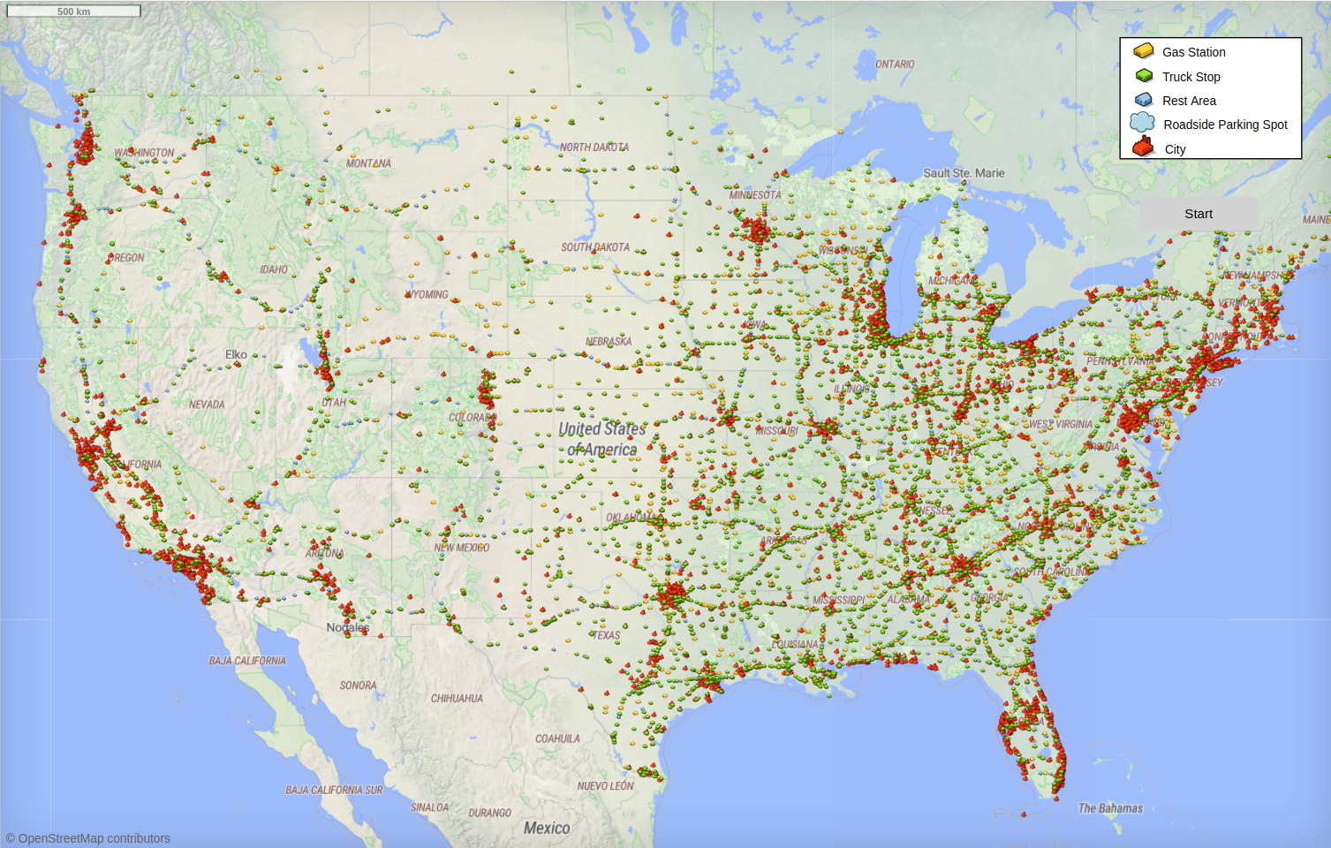

Slide 16
Model Example
...

Slide 17

Communication Across Domains
So far, mostly worked as a team of two
  Michael – health science and trucking
  Eric – scientific computing
Health and computing are different languages
How do we communicate?

Slide 18
Boundary Object
Boundary objects are objects which are both plastic enough to adapt to local needs and constraints of the several parties employing them, yet robust enough to maintain a common identity across sites.
Star and Griesemer, 1989
Boundary objects allow communication across domains
  They provide a common language

Slide 19
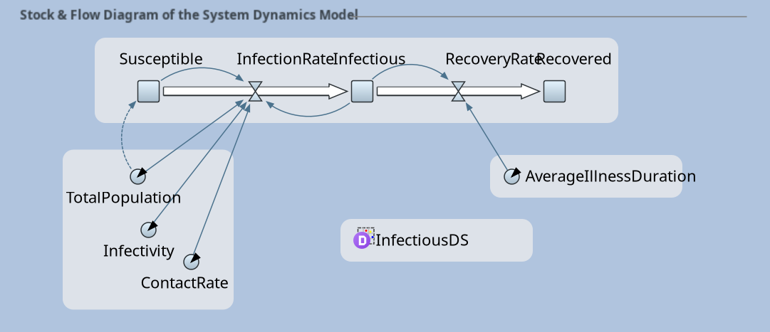
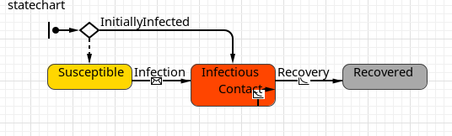
Diagrams
Diagrams are frequently used as boundary objects in modelling
  Stock and flow diagrams in SD models
  State charts in ABM models
  etc.
Many of these are built in to AnyLogic already

Slide 20
Critical Components
Communicate critical processes that drive model behaviour through boundary objects
Critical processes in trucker model:
  How do truckers decide where to stop?
  How are truckers assigned their destinations?
These are mostly decision processes.

Slide 21
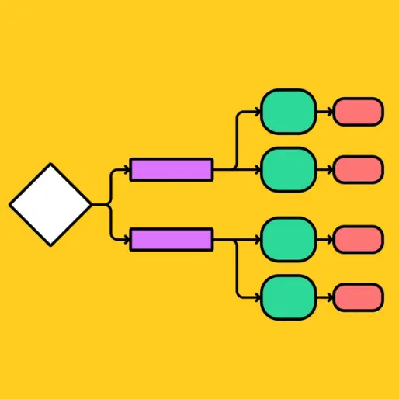
Flow Charts
Flow charts are useful boundary objects for representing a decision process
Trucker’s perspective:
  Does the flow chart match my personal experience?
Programmer’s perspective:
  Is the flow chart complete enough to implement in code?

Slide 22
Building Flow Charts
Build in collaborative sessions
Build alongside the code
  Code will reveal special cases
Our favourite tool is draw.io
  Integrated with Google Drive
  Simultaneous viewing / editing
  app.diagrams.net

Slide 23
Flow Chart Example
...

Slide 24
Next Steps
Current ABM is conceptual and will be used as a ‘case study’ for architectural approach
This is the first step in what we hope will be a broader modeling enterprise:
    Primary data collection for baseline model (parameterization, calibration, validation, etc.)
    Apply baseline model to other topics/research questions (e.g., nutrition; physical activity; infectious disease)
Notes:
Current: We are especially interested in finding out whether these four archetypes lead to emergent behavior that parallels reality!
First step: Instead of one-and-done models, we hope that this “architectural” approach can create in reproducible and more rapidly responsive research (e.g., to respond to novel threats to health/safety)

Slide 25

ModelCollab: Web-Based GMB
My own project!
“Google Docs for models”
  Group modelling over the web
Causal Loop
  Build models and analyze
    Find loops
    Rank varibales by centrality
    Etc.
System Dynamics
  Build runnable SD models
  Translate a SD model to CLD

Slide 26
ModelCollab Example
...

